Slide 1


Predict Tweets with Real Threats
Presented by
Akhil Kamble 210941225005
Rushikesh Pawar 210941225036

Slide 2
Problem statements
Every day millions of people use twitter to tweet about everyday things.
Many times these tweets contains information about a disaster from the people present near the disaster.
The news of the disaster may not reach the proper authorities in time and this can be deadly and cause loss of human lives.
We can get this data and utilize this data to send the first responders immediately to the scene to save the lives of people.
The problem is how to identify the correct disaster tweets since sometimes people may say things but it has a different meaning. For eg. Ronaldo has scored 2 goals, he is on fire. This tweet doesn’t mean Ronaldo is actually on fire.

Slide 3
How to solve this problem?
We can do this by correctly identifying the disaster tweets from large dataset of tweets.
We can use various NLP models to train and test our data and classify the tweets as true or false regarding the disaster.
For this project we have used BERT (Bidirectional Encoder Representations from Transformers) which is a language model.
We have used BERT model “bert_en_uncased_L-12_H-768_A-12” and the corresponding pre-processing model “bert_en_uncased_preprocess”

Slide 4
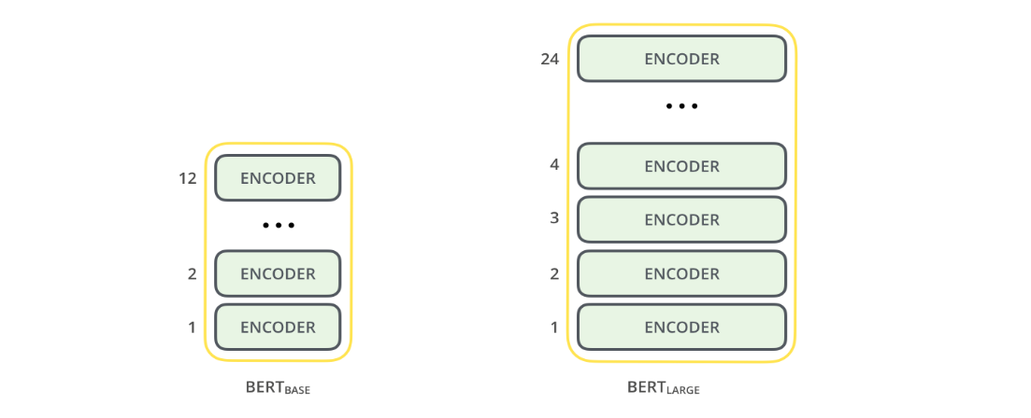
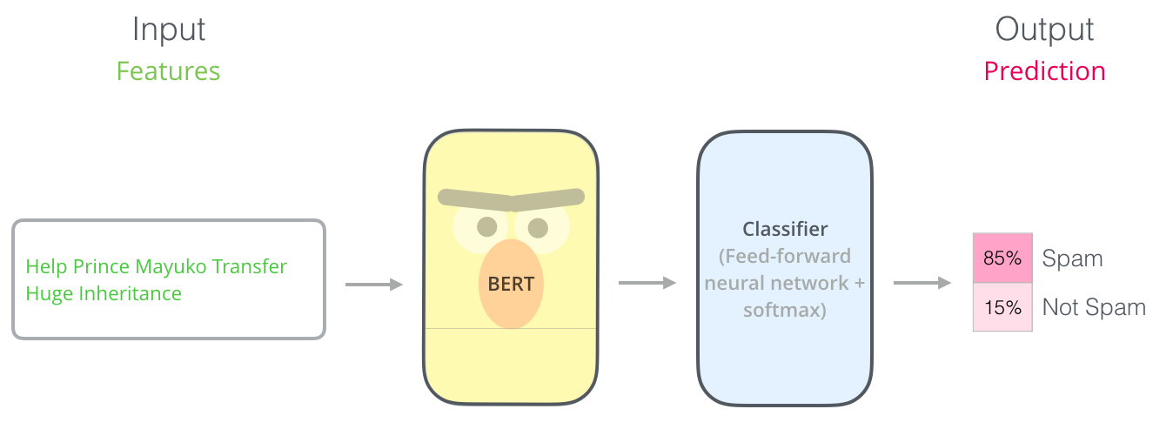
BERT
BERT model consists of multiple encoder layers whose work is to do pre-processing and then encode the inputs in some form of embeddings which can later be used by some model
BERT is from the transformer family but different in the way that it only has encoder blocks and uses only attention and feed-forward layer to generate segment embeddings.

Slide 5
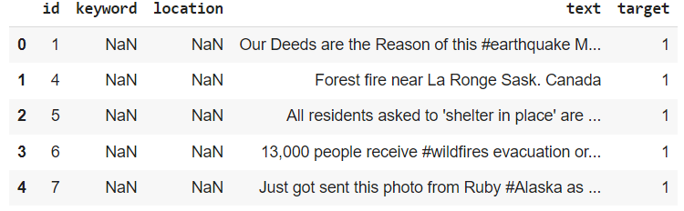
Dataset
The data set consist of 4 columns : id, keyword, location, text and target.
The keyword column contains the keywords from the text, location has the place of disaster, text contains the actual tweet and the target contains binary values. 1 for disaster and 0 for no disaster.

Slide 6
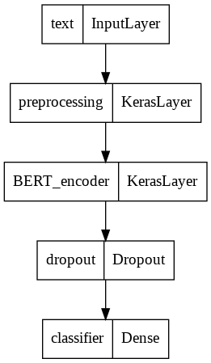
Process Flow Diagram

Slide 7
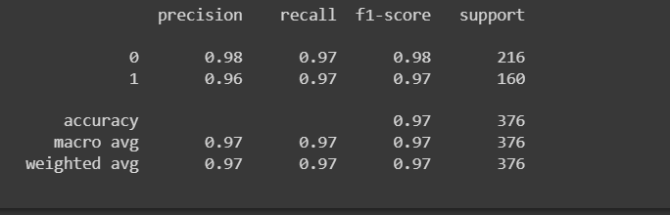
CLASSIFICATION REPORT BERT

Slide 8
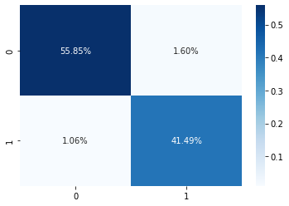
Confusion matrix

Slide 9
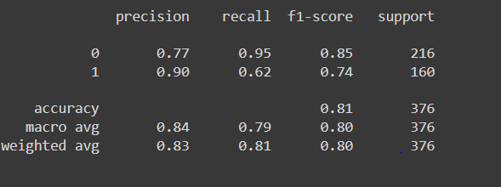
CLASSIFICATION REPORT MULTINOMINAL NAÏVE BAYES

Slide 10

Disaster tweet

Slide 11
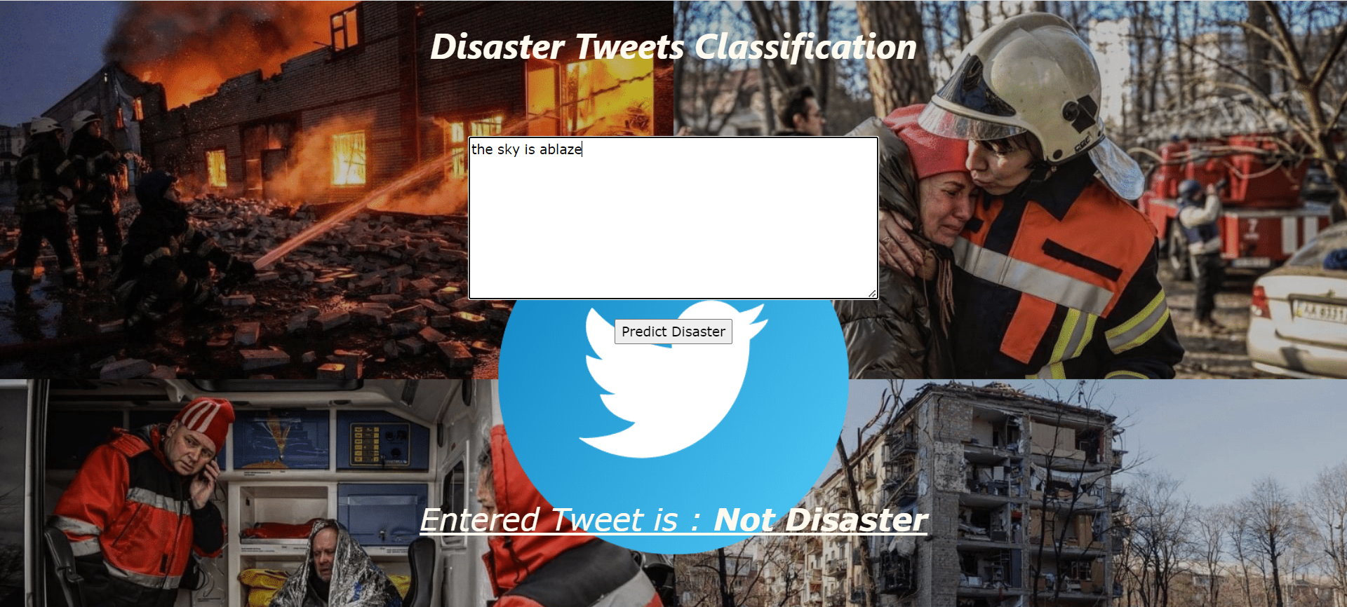
Non-disaster tweet

Slide 12
Conclusion
In this project we have built a system for classifying a tweet into real disaster tweet or not.
For Model building we gathered the data from Kaggle.com
We cleaned the data of any special characters. Performed Label Encoding on the response variable
We did Exploratory Data Analysis to get inputs regarding the dataset
Built a BERT model and Multinomial Naive Bayes on the cleaned dataset. Found out BERT to be the best model.

Slide 13
Future Scope
We can increase the accuracy even more by using other BERT models depending on the need and usage.
Useful in dealing with disaster relief and recovery. Many disaster relief organizations monitor Twitter’s data.

Slide 14
Thank You

